Slide 1
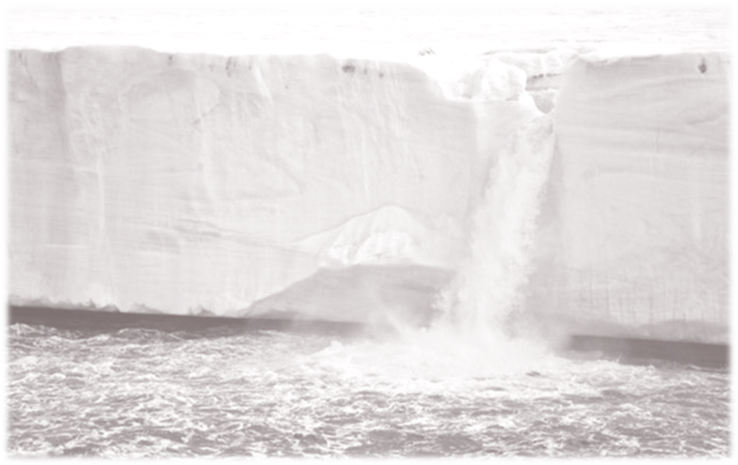
ICESat-2: Measuring the Height of Earth One Photon At a Time
Tom Neumann
Project Scientist, ICESat-2
NASA Goddard Space Flight Center
On behalf of the entire ICESat-2 Science Community

Slide 2

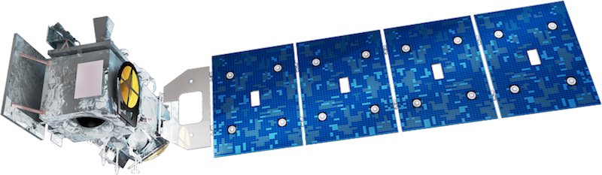


Covering the world with soothing green light

Slide 3
ICESat-2 Objectives
Quantify polar ice-sheet contributions to current and recent sea-level change and the linkages to climate conditions
Quantify regional signatures of ice-sheet changes to assess mechanisms driving those changes and improve predictive ice sheet models; this includes quantifying the regional evolution of ice sheet change, such as how changes at outlet glacier termini propagate inward.
Estimate sea-ice thickness to examine ice/ocean/atmosphere exchanges of energy, mass and moisture;
Measure vegetation canopy height as a basis for estimating large-scale biomass and biomass change.

Slide 4
ICESat-2 Measurement Concept
Pointing Angle
Lidar
Range Measurement
Geoid
GPS
Elevation
Surface
Spacecraft Altitude
We want to measure elevation
Lidar measures range (time of flight) and absolute pointing angle
GPS measures position in orbit
Ground processing puts the pieces together

Slide 5
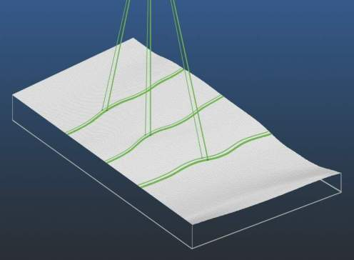
ICESat-2 Measurement Concept
Single laser pulse at 532nm, split into 6 beams. Single-photon sensitive detection.
flight direction
flight direction
3 km
3 km
3 km
3 km
90 m
Footprint size: 17 m
PRF: 10 kHz (0.7 m)
3 km spacing between pairs provides spatial coverage
90 m pair spacing for slope determination (2° yaw)
high-energy beams (4x) for better performance over low-reflectivity targets.

Slide 6
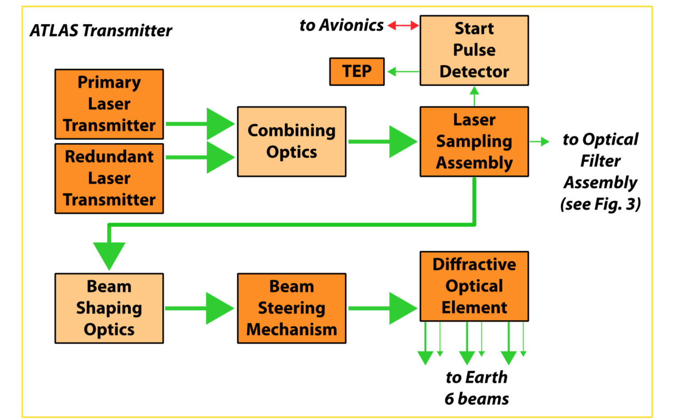
ATLAS Transmitter

Slide 7
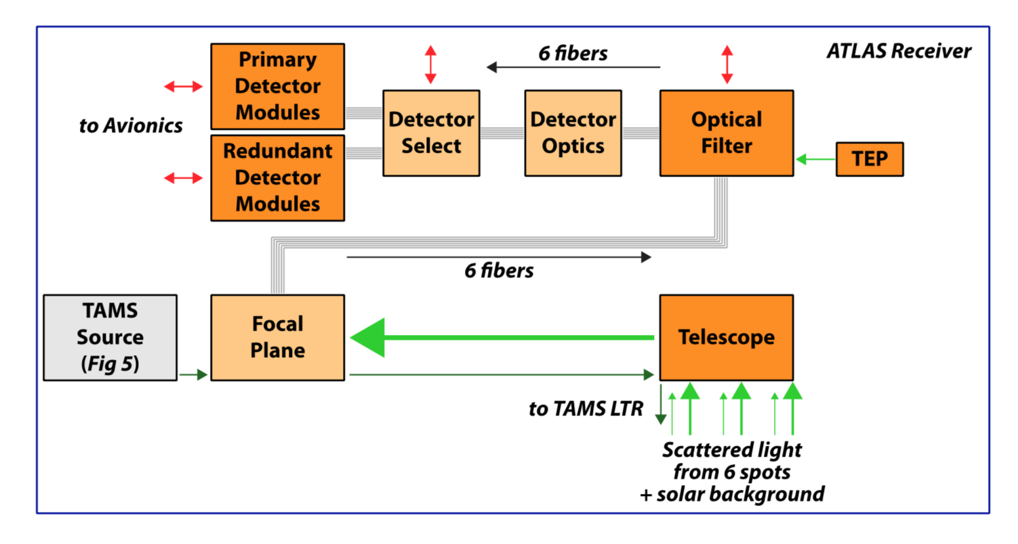
ATLAS Receiver

Slide 8
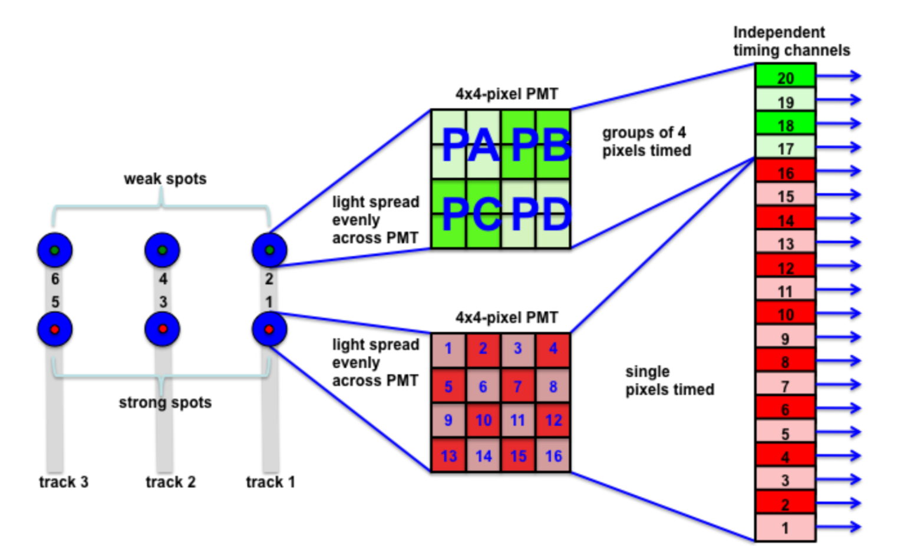
ATLAS Timing

Slide 9
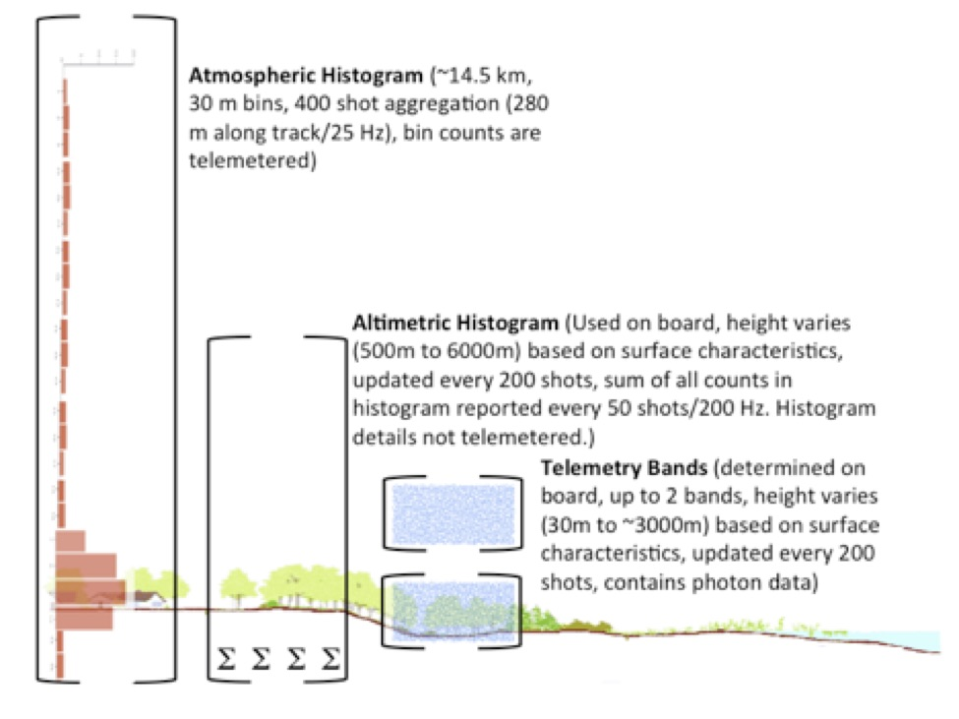
ATLAS Data Selection
Used in ATL04 and 09
Photons for data products

Slide 10
ATLAS Instrument Details
Transmitter
wavelength (nanometers) | 532.272
footprint diameter (m; microradians) | ~12; <35 at 85% ee
pulsewidth (nanoseconds, FWHM) | < 1.5
pulse energy (millijoules) | 0.2 to 1.2
optical throughput efficiency | 73%
number of beams; energy ratio (weak:strong) | 6; 4:1
nominal strong beam (microjoules) | 200 (adjustable)
nominal weak beam (microjoules) | 50 (adjustable)

Slide 11
ATLAS Instrument Details
Receiver
telescope diameter (m) | 0.8
receiver field of view (m, microradians) | 42.5, 83.3
optical filter bandpass (picometers) | 30
optical throughput efficiency | 42%
detector efficiency | 15%
single photon precision (m, picoseconds) | 0.23, 775
max signal photons per shot, strong | 10
max signal photons per shot, weak | 2.5

Slide 12
Low-Level Products
Data from S/C downlinked ~7x / day
Ground stations in Svalbard and Poker Flat, AK
NASA networks brings data to GSFC
~450 Gbit / day
ATL01
Unpacks Data / conversion from binary
Stored in HDF5 format
ATL02
Applies conversions to yield times, temperatures, voltages
Photon time of flight calculated
Organized by beam
All other S/C data (star trackers, GPS) passed through

Slide 13
ATL03: Geolocated Photons
Position of observatory in space:
Precision Orbit Determination – NASA GSFC
Based on Ruag GPS receivers
verified with satellite laser ranging (orbit known to < 3 cm radial)
Pointing vectors for ATLAS laser beams:
Precision Pointing Determination – U of Texas Applied Res. Lab
Based on Sodern Star Trackers and Laser Reference System
verified with ATL03 photon data
Photon time of flight + POD + PPD → Photon ground bounce point
One photon precisely geolocated every 20m, others geolocated WRT
Along-track geolocation segment / reference photons

Slide 14
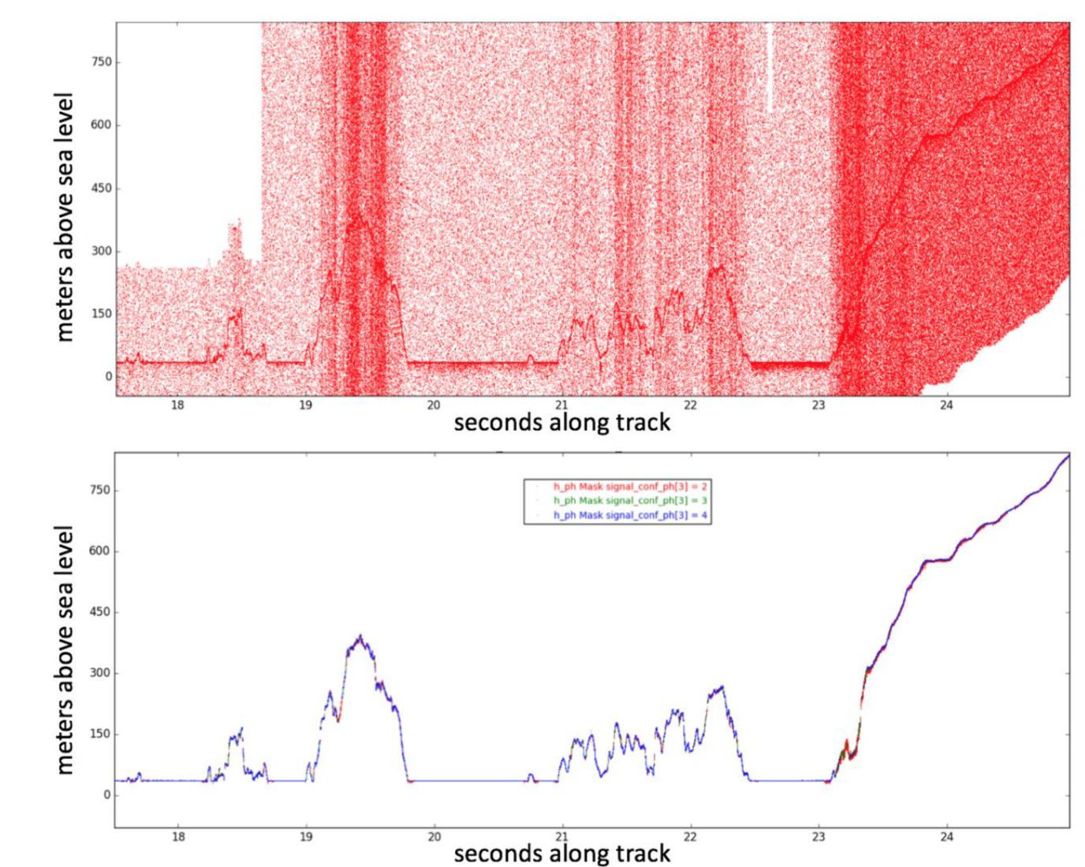
ATL03: Geolocated Photons
Classify Photons
Reduce data volume higher-level products have to deal with
Histogram-based approach
Parameters are surface specific
Likely signal photons w/ high, medium or low confidence

Slide 15
ATL03: Geophysical Corrections
Model Type | Input Params | Output Params | Applied? | Processing/Source Candidates
Ocean Tides | lat, lon, time | ocean height correction | R | GOT4.8 – in-house support
Met Data | lat, lon, time | surface and column temperature, pressure | R | NASA GMAO GEOS5 FP-IT
IB/DAC | lat, lon, time | ocean height correction | R | MOG2D (AVISO)
Ocean Loading | lat, lon, time | ocean height correction | C | GOT4.8 – supplemental files
Solid Earth Pole Tide | lat, lon, time | solid earth deformation | C | IERS Conventions (2010)
Ocean Pole Tide | lat, lon, time | ocean height correction | C | IERS Conventions (2010)
Solid Earth Tides | lat, lon, time | solid earth deformation | C | IERS Conventions (2010)
Geoid | lat, lon | reference surface | R | EGM2008, mean tide system
Geocenter Motion | time | Cartesian shift of tracking stations | N | Via SLR/GPS estimation, applied in POD
Total Column Atmospheric correction | lat, lon, time | range correction | C | Recommendation by Luthcke & Petrov, cf. ATBD ATL03a

Slide 16
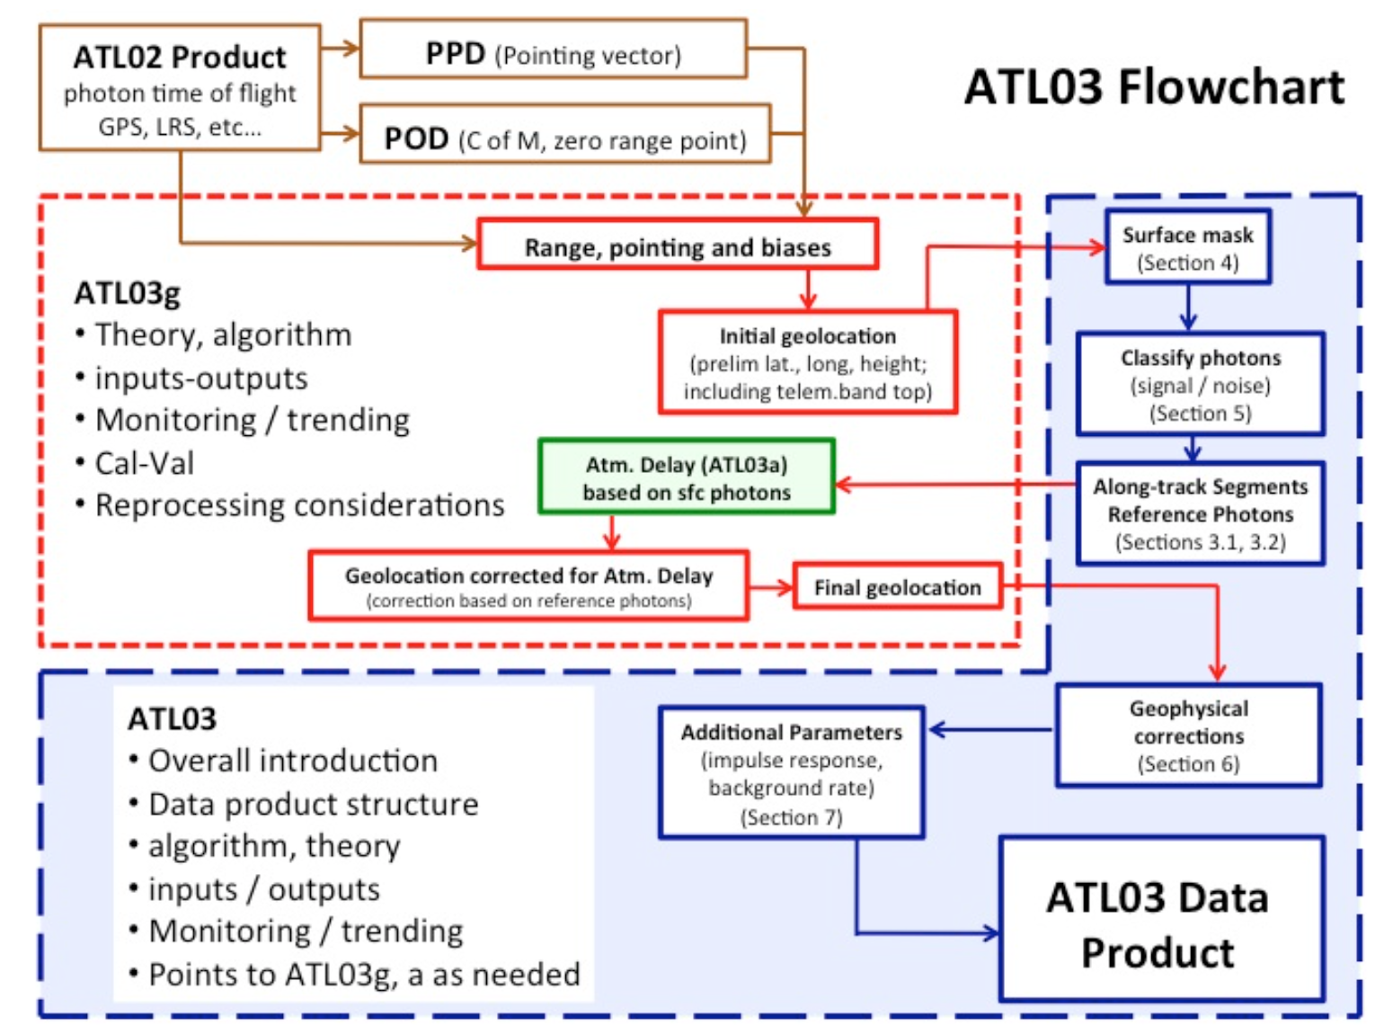
ATL03: Geolocated Photons

Slide 17
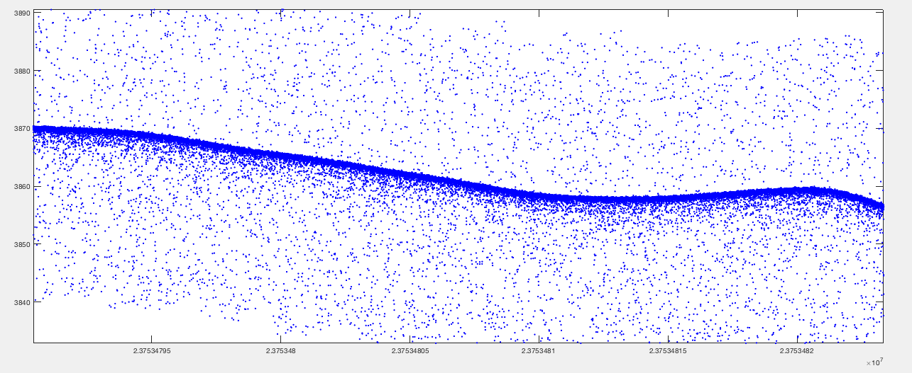
First ATL03: 3 October 2018
Latitude, longitude, height for every photon (WGS-84 ellipsoid / ITRF-2014)

Slide 18
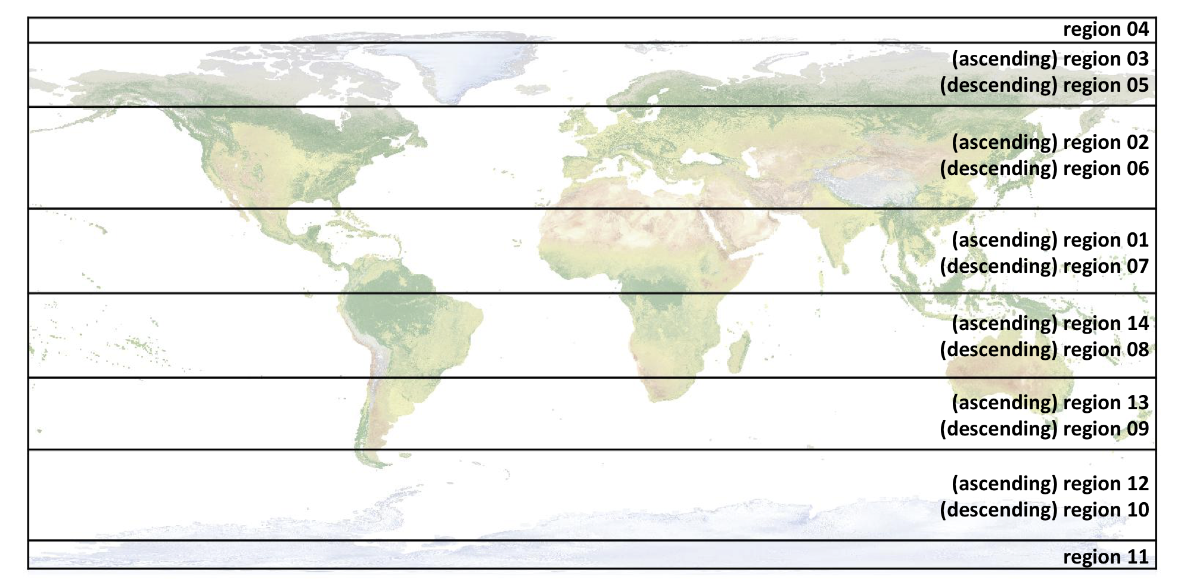
ICESat-2 Regions

Slide 19
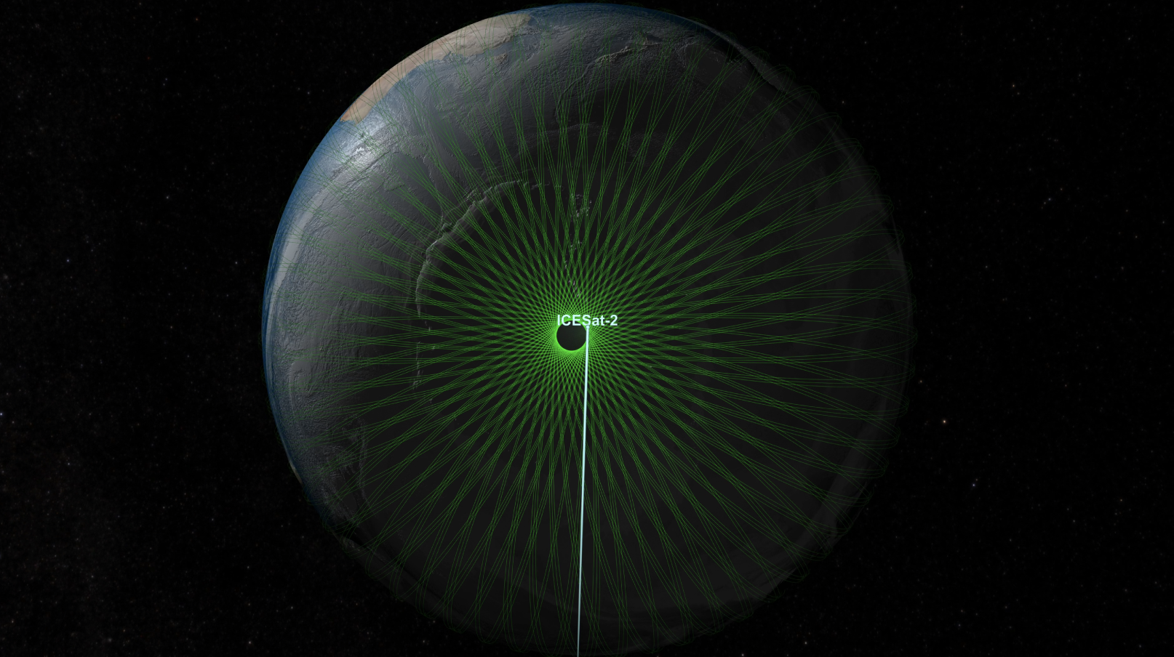
Orbit Coverage
500 km altitude
88S to 88N
15 revs/day
1387 tracks
91-day revisit
Ground tracks at icesat-2.gsfc.nasa.gov

Slide 20
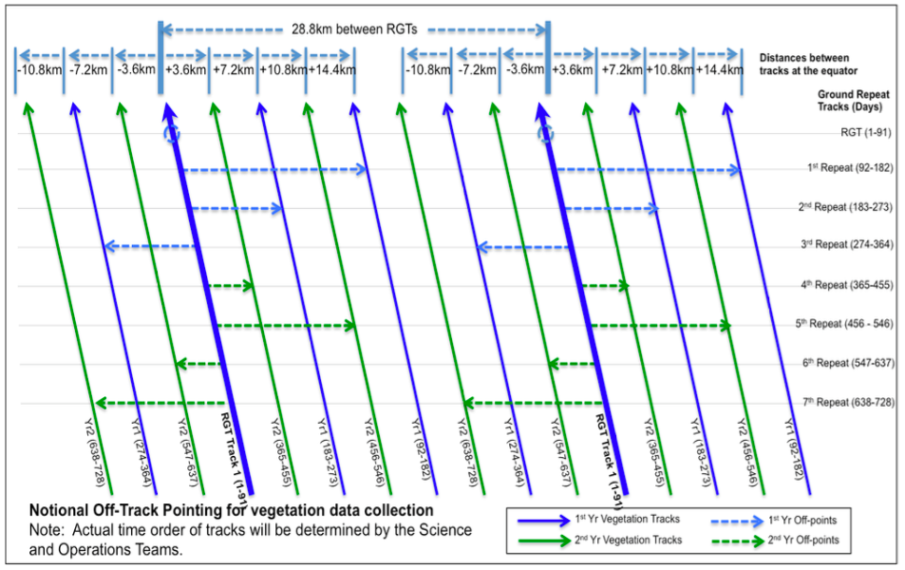
Off-pointing in Mid-Latitudes

Slide 21
Orbit and Cross Overs
ICESat-2’s orbit:
91-day exact repeat orbit with monthly sub-cycle
Inclination: 92º (88º north and south)
Altitude: ~500 km
Driven by:
Seasonal requirement for ice sheet changes
Monthly requirement for sea ice
Compromise between high-latitude coverage and cross-over distribution
Cross-Overs:
With 6 beams, each ground track cross-over generates
36 individual crossings. … or 9 slope-corrected crossings
Primary method of monitoring ATLAS range bias and data consistency

Slide 22
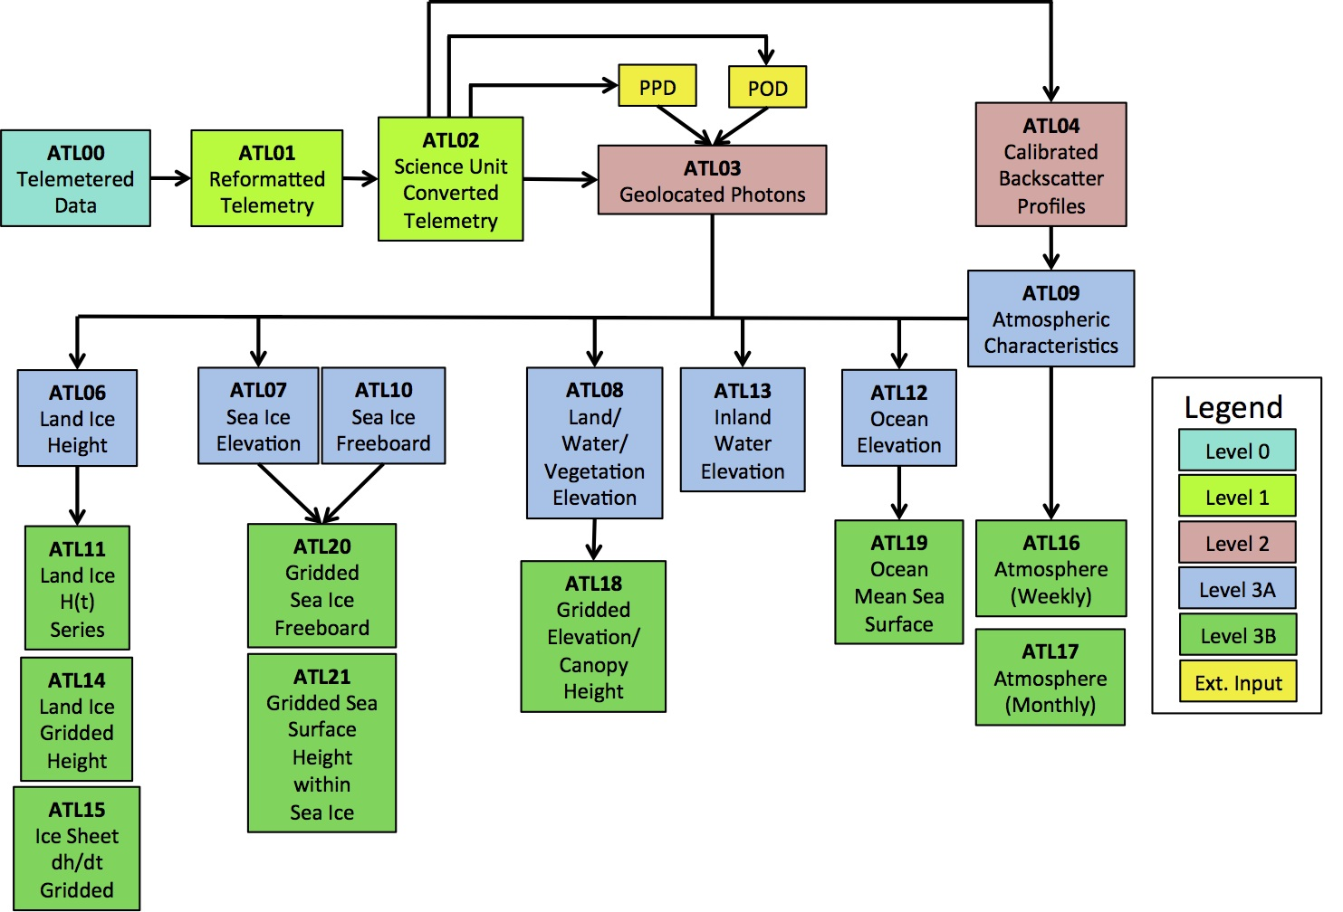
ICESat-2 Data Products
All along track products at NSIDC, and some gridded products too!

Slide 23
Data Product Leads
ATBD | Lead | Affiliation | ATLAS Science Data Products | Description
Precision Pointing Determination (PPD) | Sungkoo Bae | UTCSR | ancillary data | Precise laser pointing solutions input to all level 2 and higher level products
Precision Orbit Determination (POD) | Scott Luthcke | GSFC | ancillary data | Precise orbit solutions input to all level 2 and higher level products
Level 1A | John DiMarzio | SGT/GSFC | ATL01 | Conversion and reformatting of Level 0 data
Level 1B | Tony Martino | GSFC | ATL02 | Apply necessary corrections from housekeeping data, e.g. calibrated ranges
Level 2A | Tom Neumann | GSFC | ATL03 | combine elevation corrections, geolocation information, laser spot location (which requires preliminary surface finding) with L1B product; also will produce histograms
Ice Sheet | Ben Smith | UW | ATL06, 11, 14, 15 | Define ice sheet products and parameters
Sea Ice | Ron Kwok | JPL | ATL07, 10, 20, 21 | Define sea ice products and parameters
Land | Amy Neuenschwander | UT-ARL | ATL08, 18 | Define land and vegetation products and parameters
Ocean | James Morison | UW | ATL12, 19 | Define ocean products and parameters
Atmosphere | Steve Palm | SSAI/GSFC | ATL04, 09, 16, 17 | Define atmosphere products and parameters and the calibrated backscatter
Inland Water and Snow | Mike Jasinski | GSFC | ATL13 | Surface height and slope of inland water bodies

Slide 24
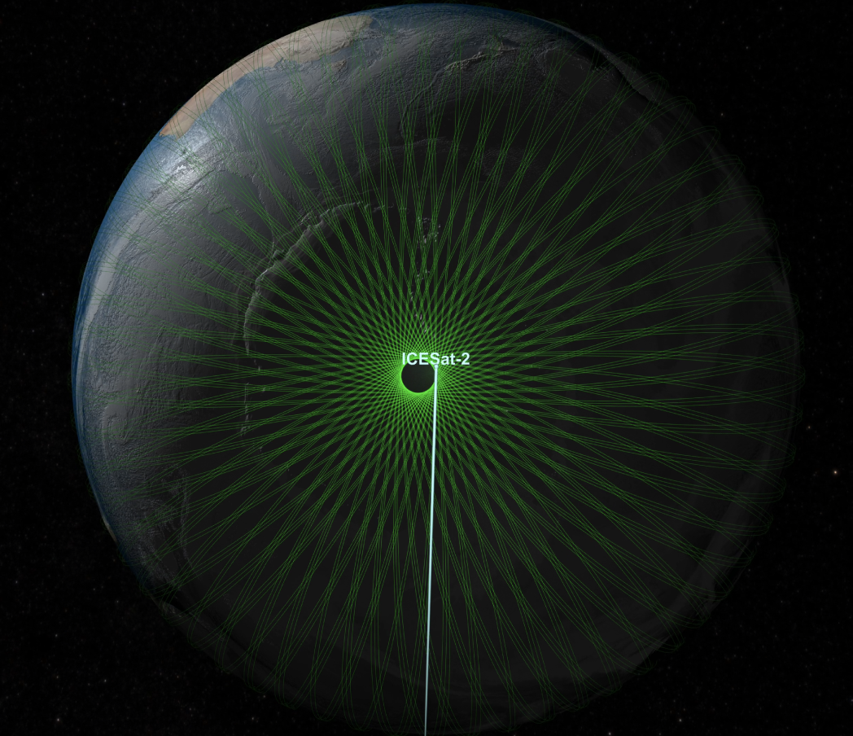
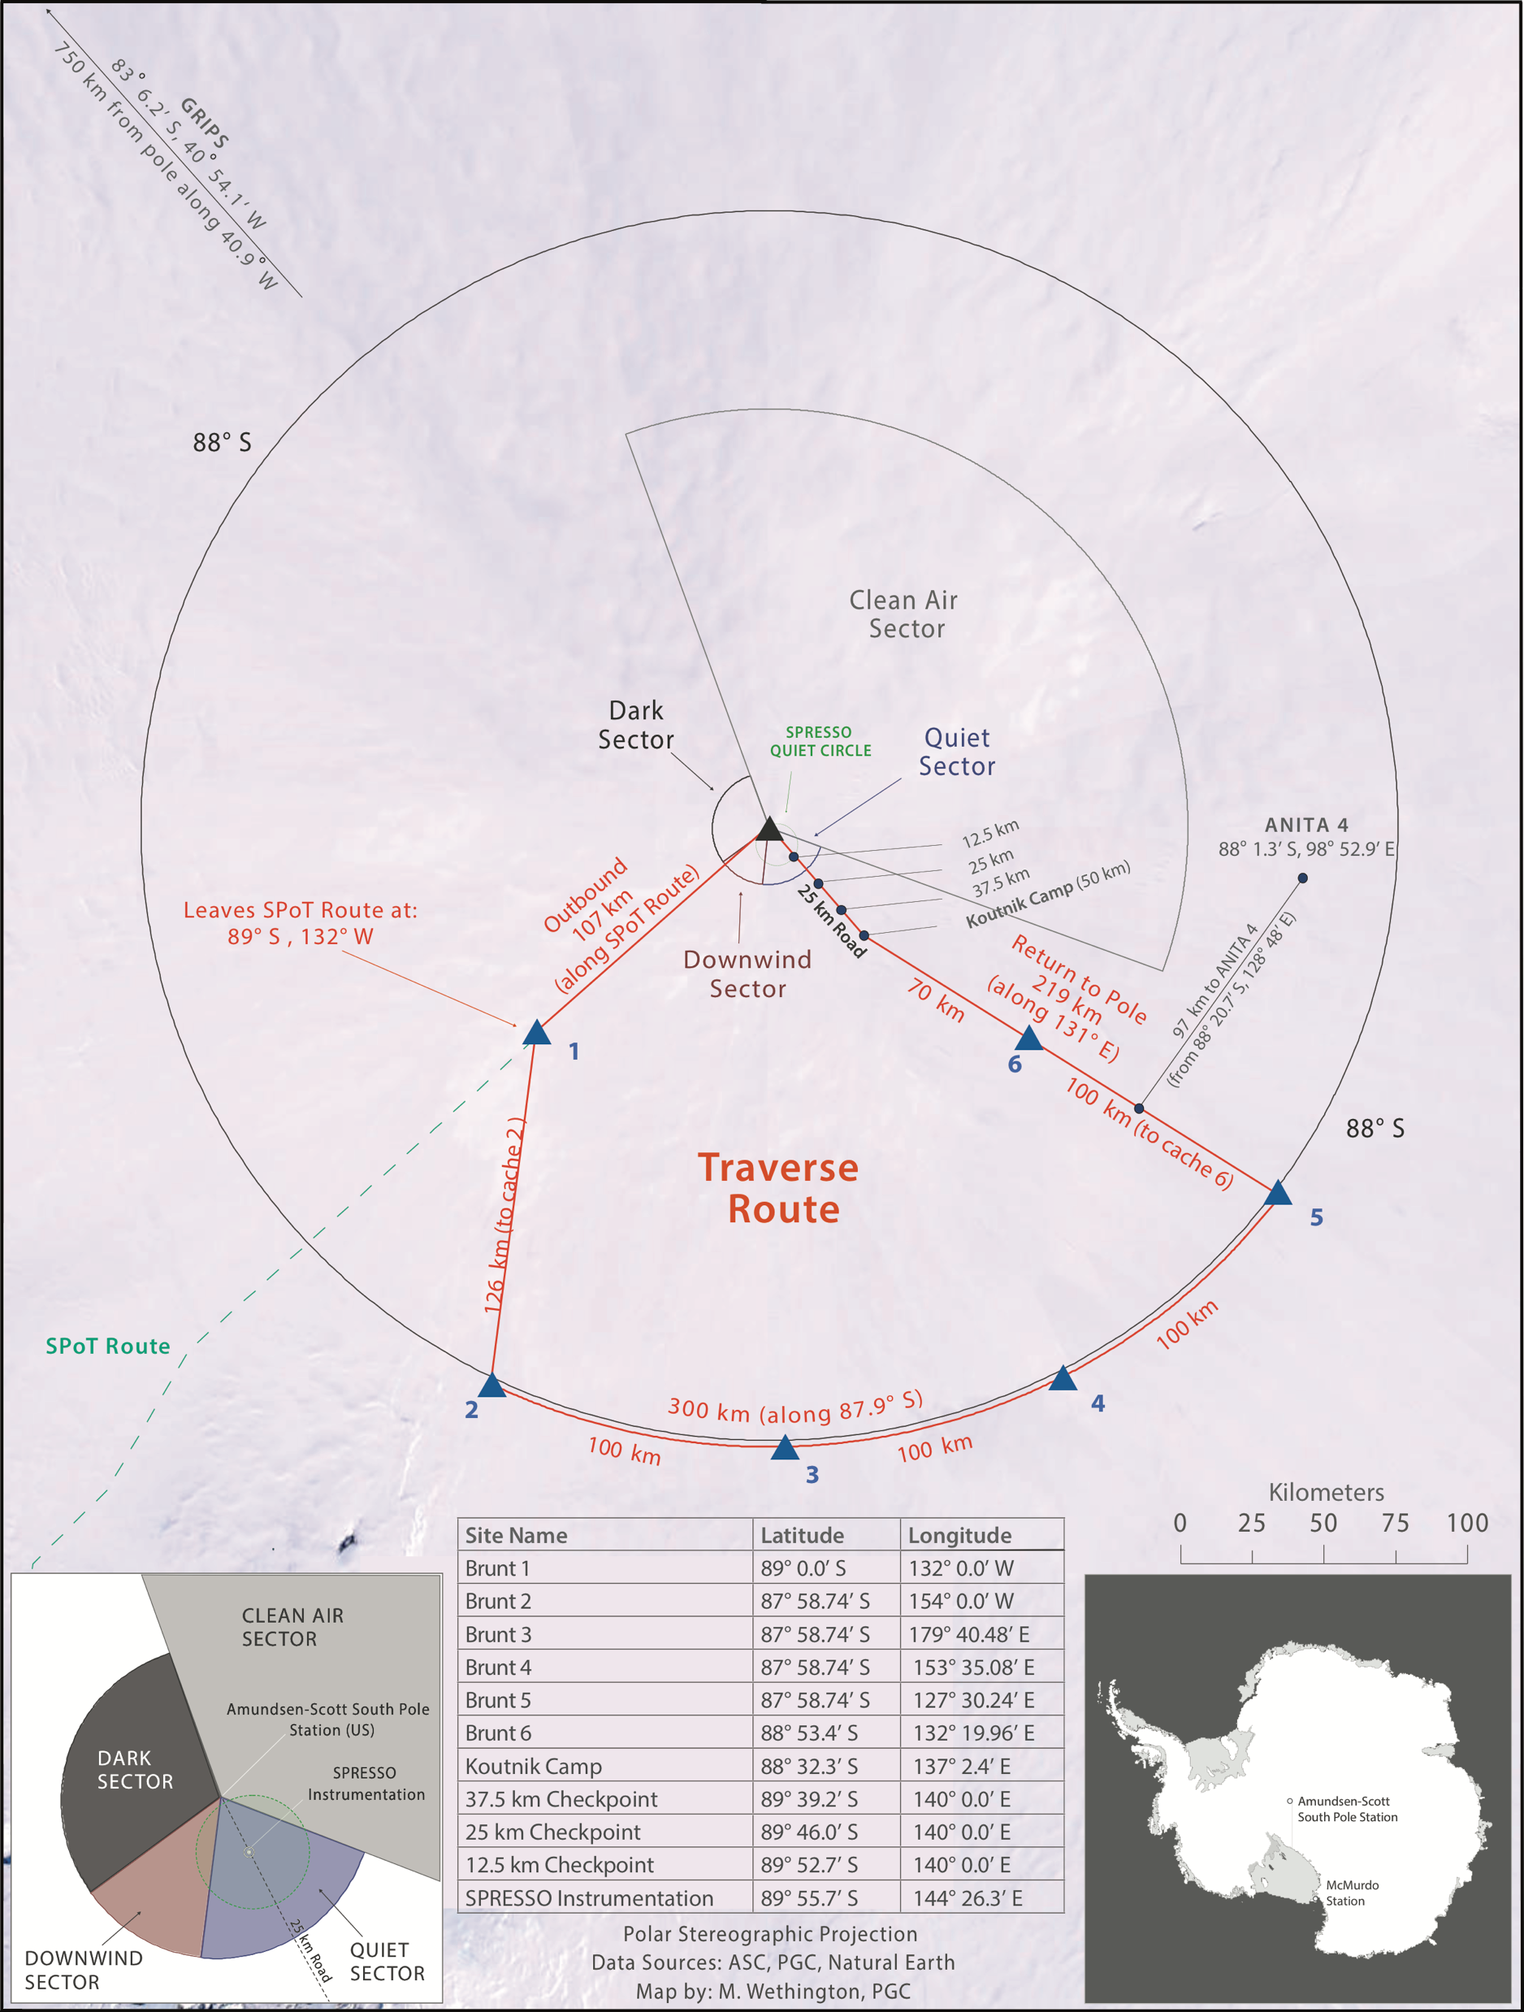
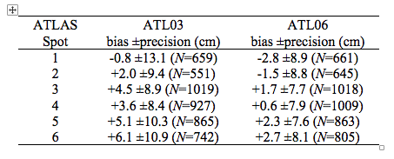
Calibration Activities
Brunt, Neumann, and Smith (Geophysical Research Letters, 2019)

Slide 25
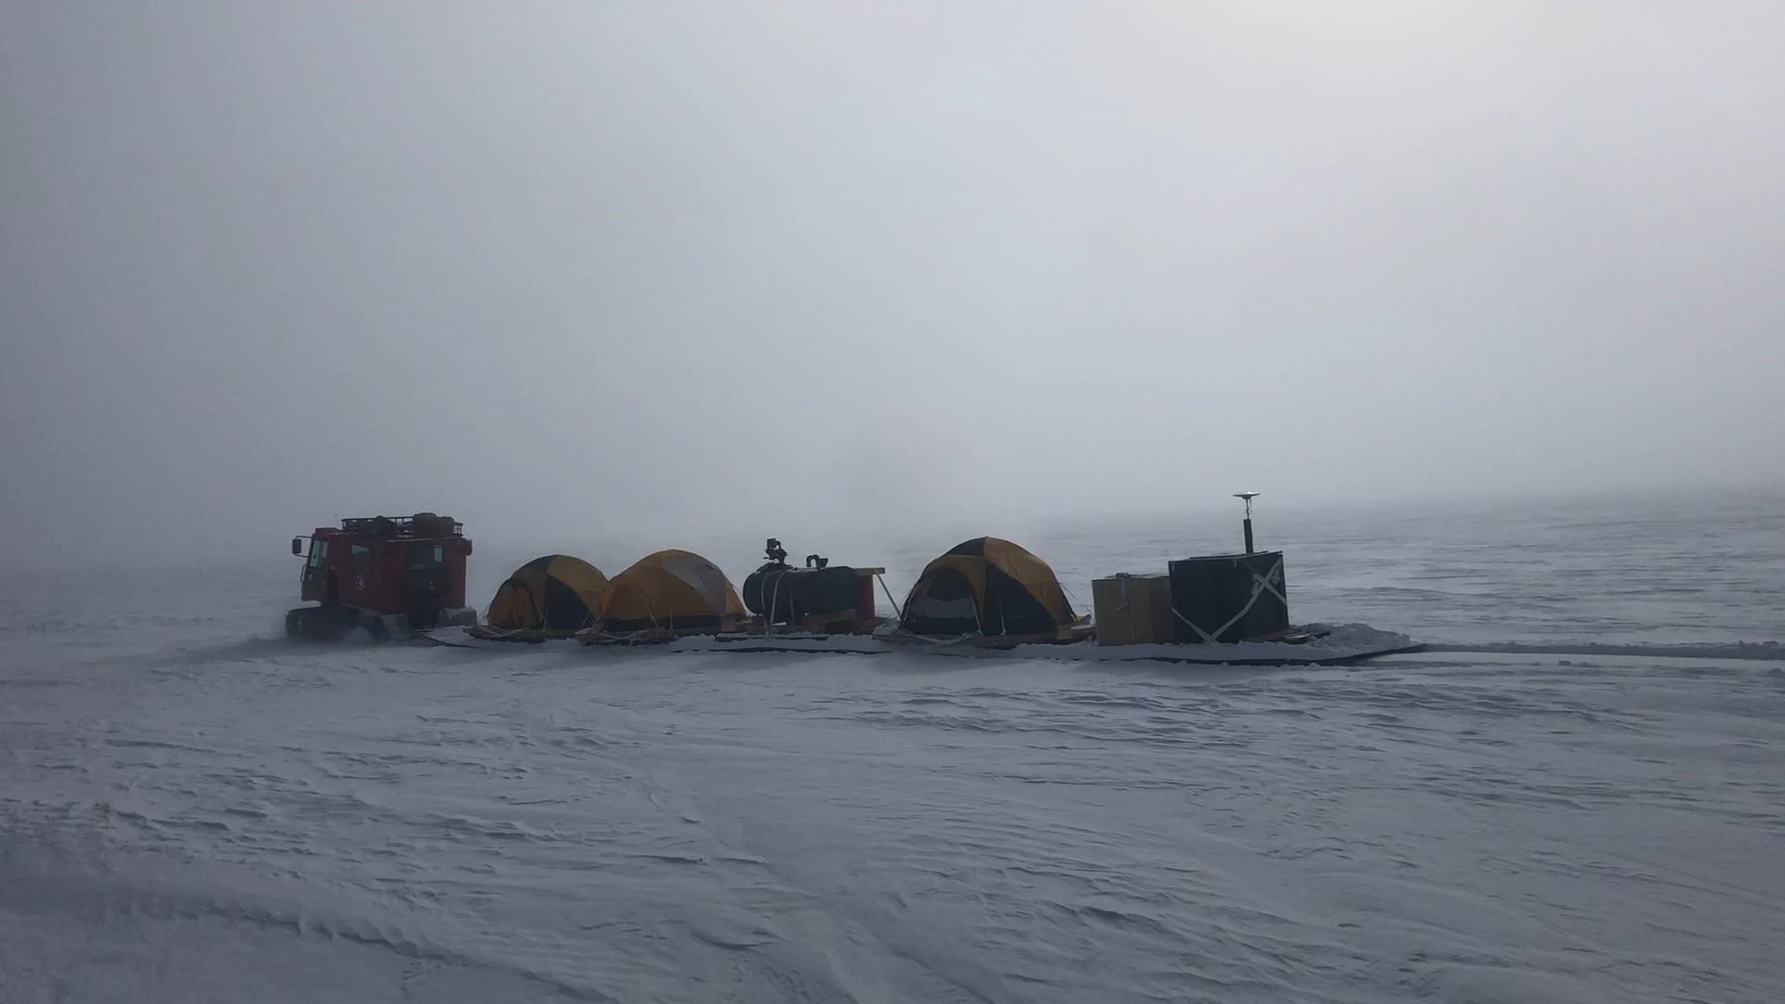
Calibration Activities

Slide 26
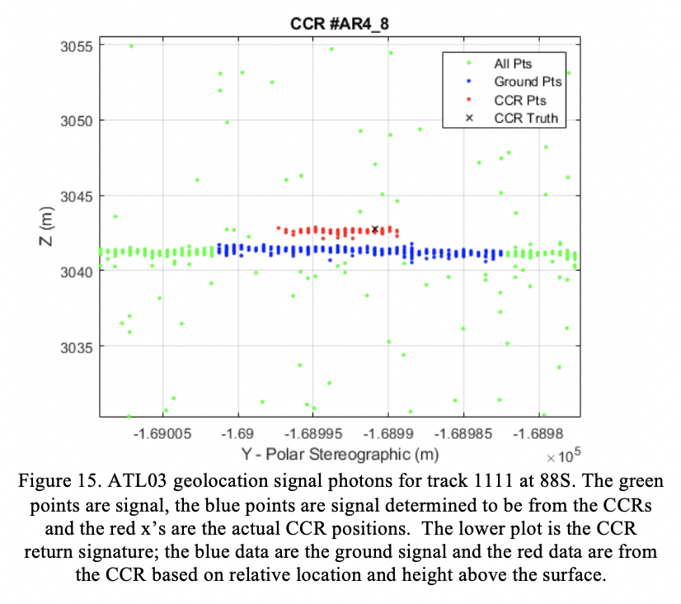
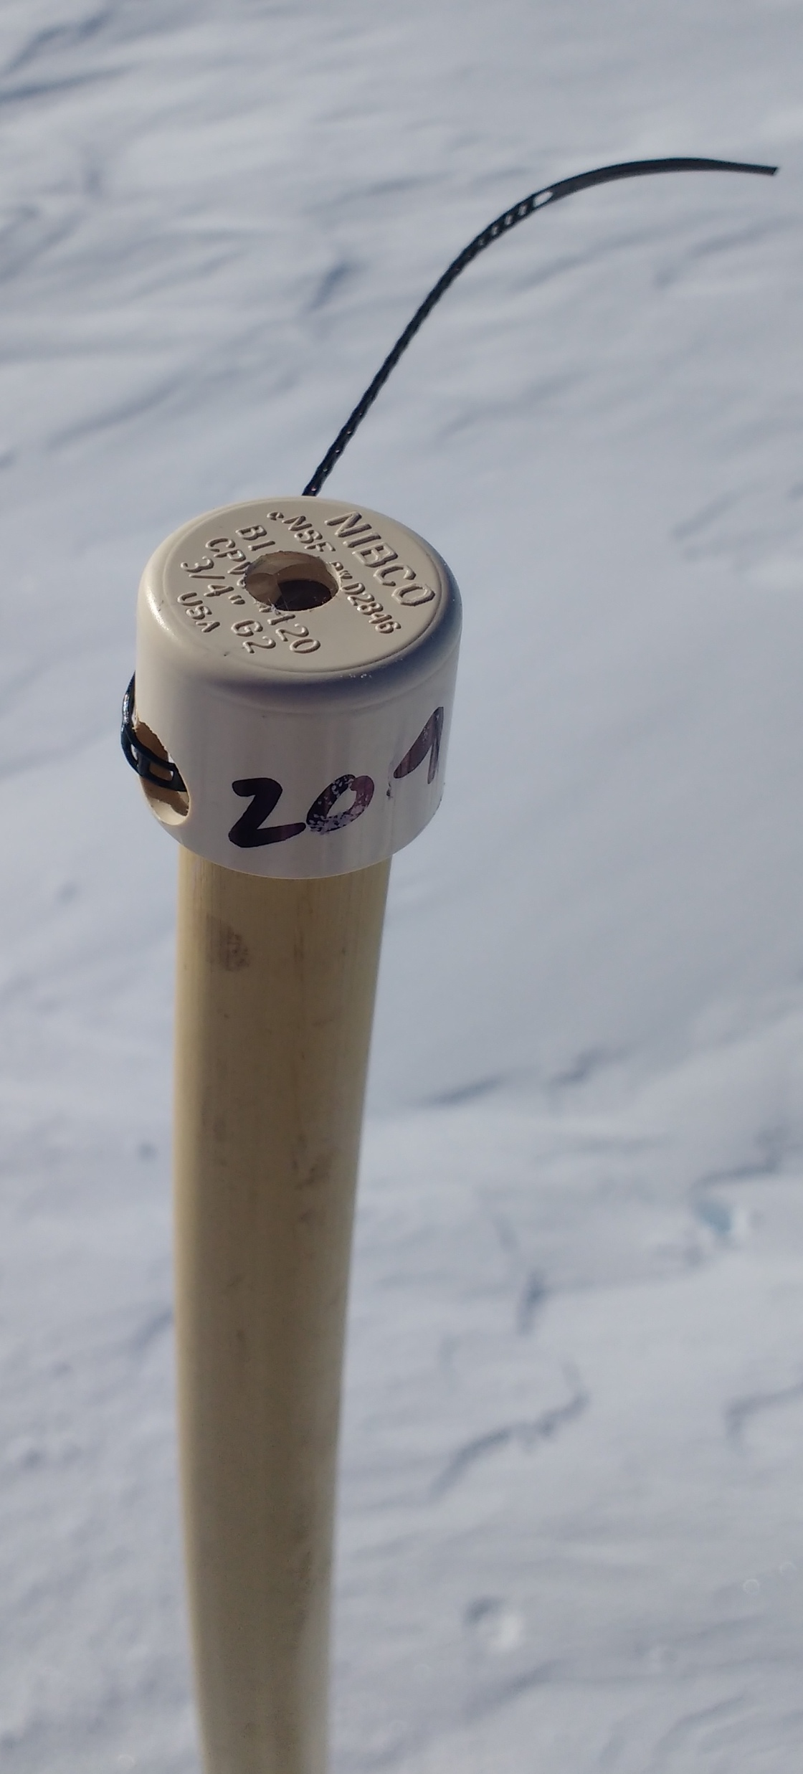
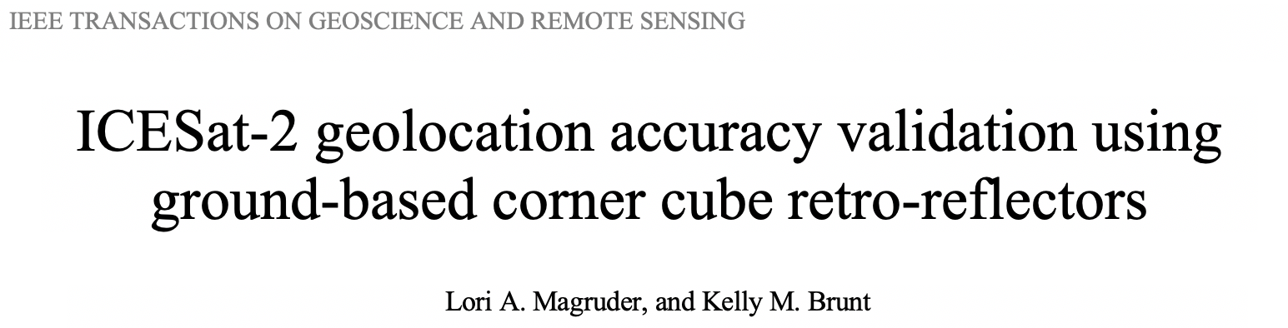
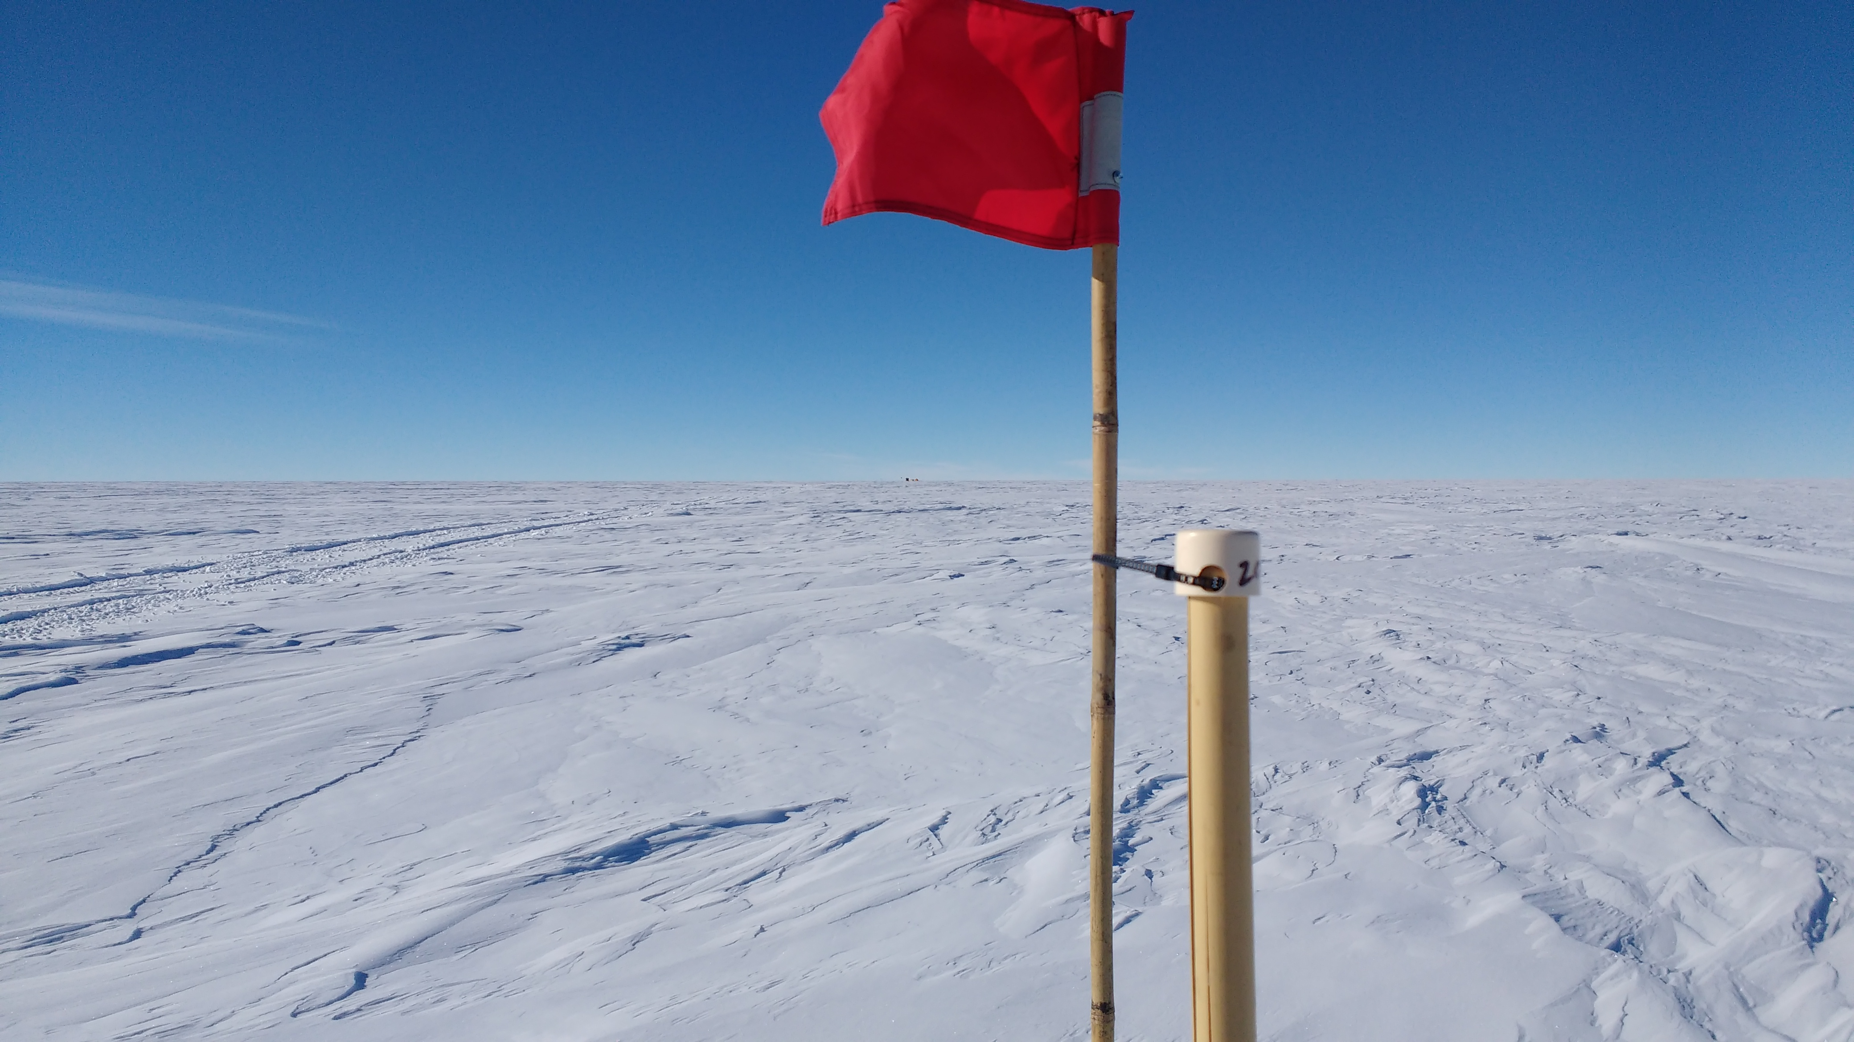
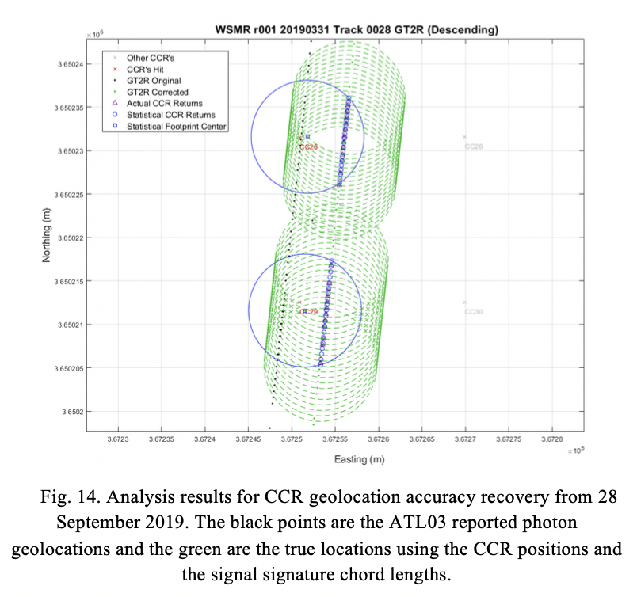
Calibration Activities
ICESat-2 footprint: 12.7 m
(CBE, pre-launch: 17 m)

Slide 27
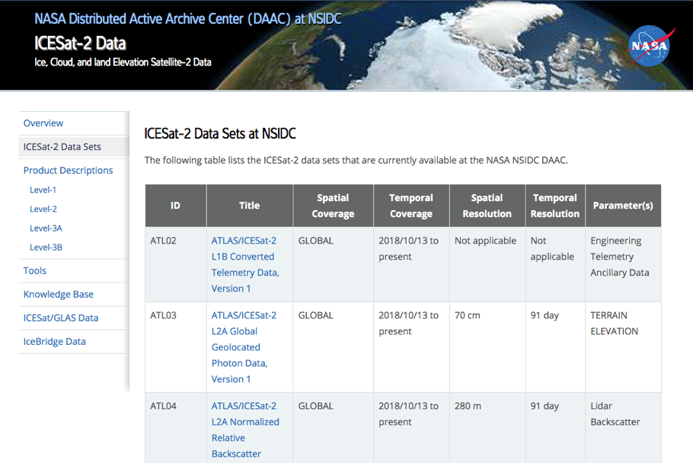
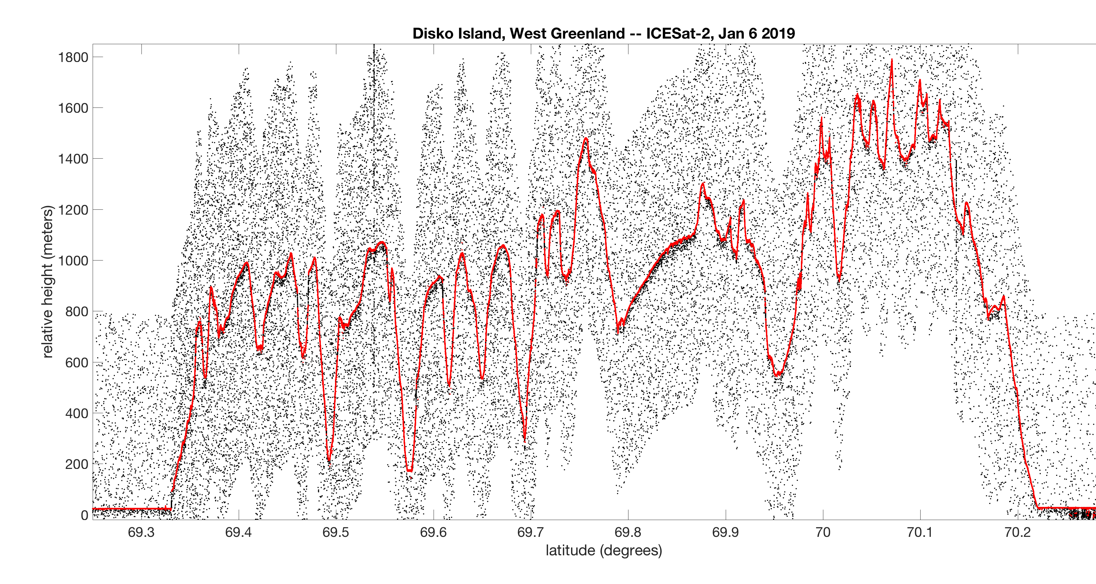
ICESat-2 Data are Publicly Available
National Snow and Ice Data Center (NSIDC DAAC)
Data Products:
Geolocated Photons
Land Ice Elevation
Sea Ice Elevation and Freeboard
Land Elevation
Atmospheric Backscatter
Ocean Surface Height
Inland Water Elevation
Rugged topography in Greenland
1955 unique data users to date
From 82 countries
5,289,808 files served from 28 May 2019 – 1 June 2020

Slide 28
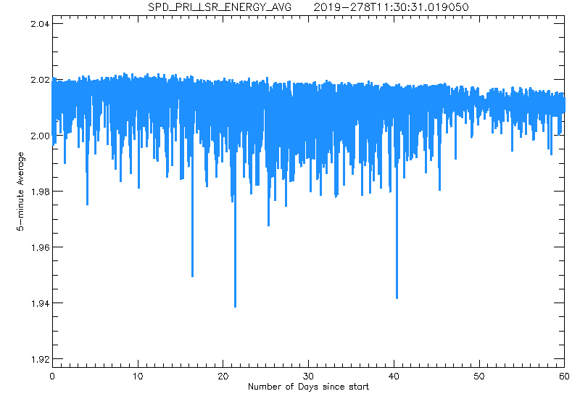
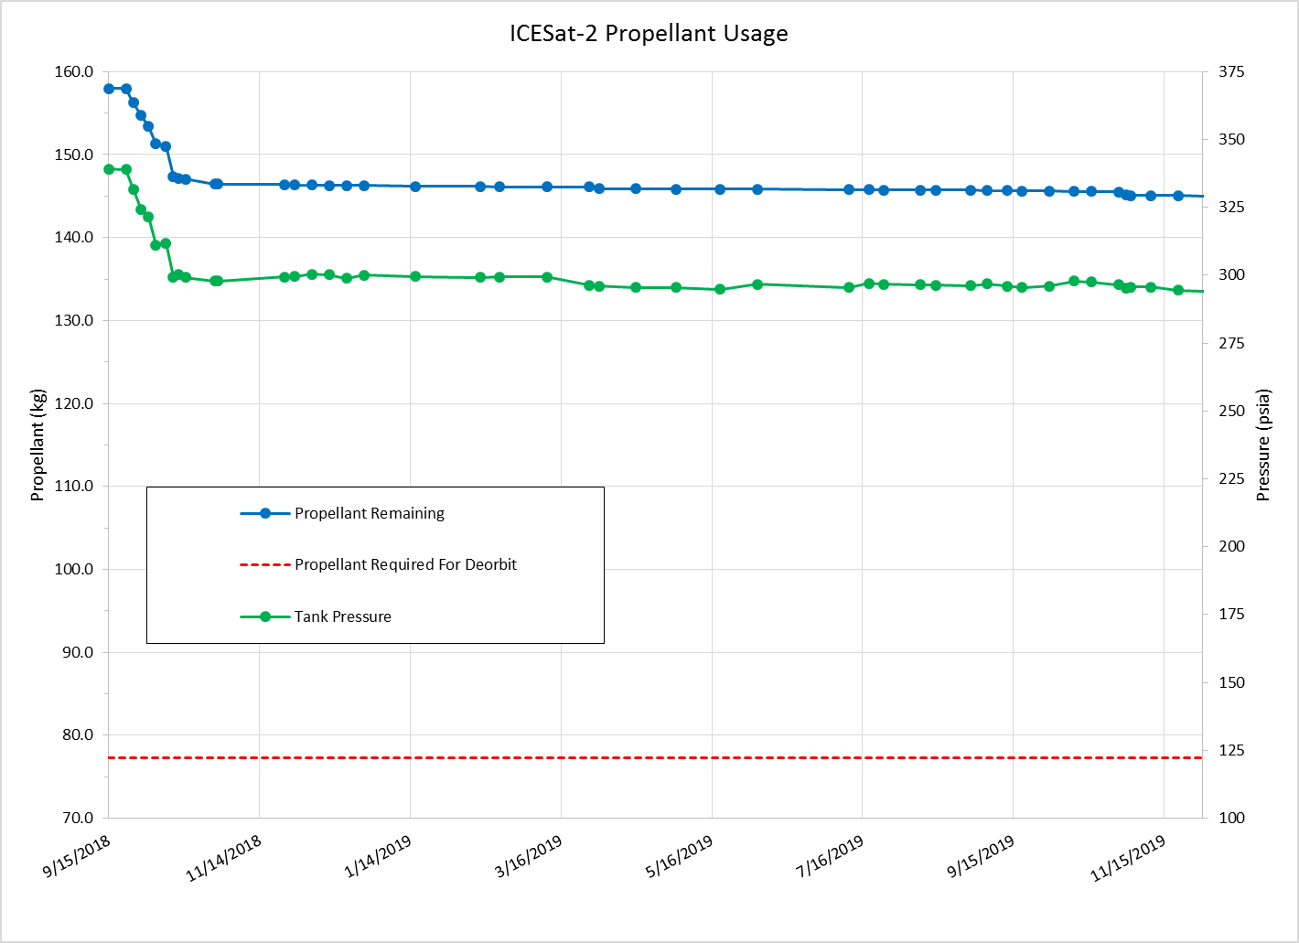
ATLAS Remains Nominal
One safehold event (26 Jun – 9 July)
And two ATLAS software upsets (7 Nov and 26 Dec 2019)
Otherwise, observatory remains nominal.
ATLAS Laser Pulse Energy 60-day trend
Fuel is not likely a limiting factor
Laser transmit energy remains within +/- 2.5% of prelaunch value
Laser lasing at energy level 4 …. of 11
Steps spaced by ~10% between 0.2 and 1.2 mj

Slide 29
ICESat-2: Measuring the Height of Earth One Photon At a Time
ICESat-2 is well on it’s way to nominal science data production.
After 600 Billion shots (as of 1 June) ATLAS is stable and healthy.
Release 003 data from 14 October 2018 to 6 April 2020 available. More on the way!

